Slide 1

OPENSPENDING
Making budget data accessible with tools and fiscal standards
PRESENTED BY
ANDERS PEDERSEN
Open Knowledge

Slide 2
It started with a question:
Could budget data make more sense to us as citizens?

Slide 3
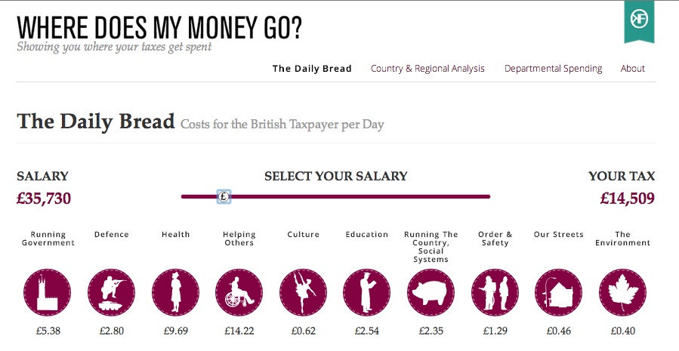

Slide 4
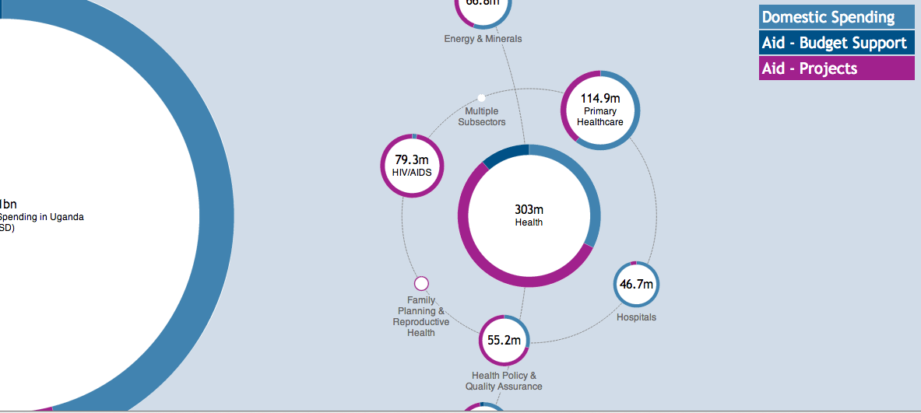
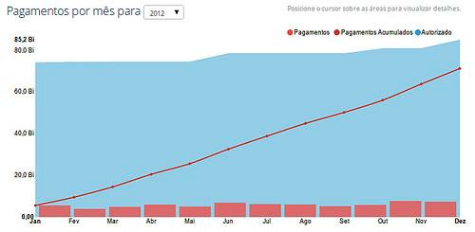


A few successes
Breaking data silos and providing insight: OpenSpending was used to connect aid & budgets for the first time in Uganda - providing the government with important new insight (2010);
Community driven sites already in over 200 locations globally;
Used both by governments & civil society (Romania, Uruguay, UK).
Research on fiscal transparency and standards
Impact

Slide 5
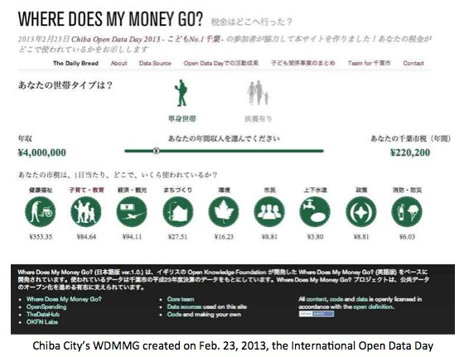
Significant community uptake
Germany: Several city budgets published, references to OpenSpending in local city regulation
Japan: +150 city based deployments of OpenSpending
Globally: 70 countries, 800 datasets, 26 mio. transactions
Significant community uptake

Slide 6
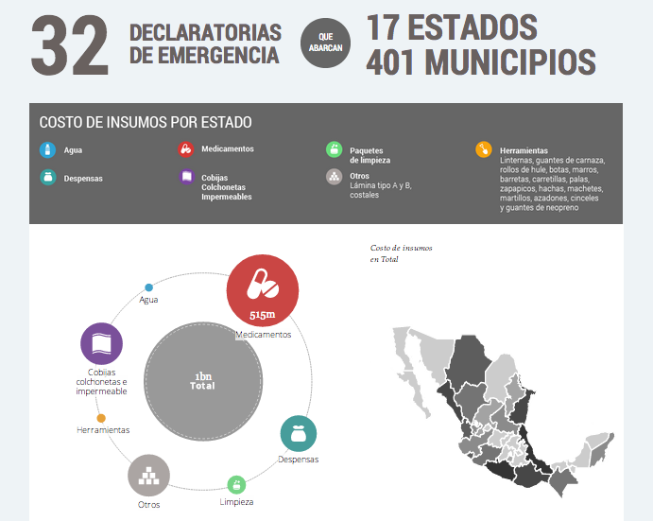
Government of Mexico
Visualisation of the natural disaster fund
Tailored map of 32 provinces developed in-house
Next step: OpenSpending / CKAN integration
Pilot budget transparency

Slide 7
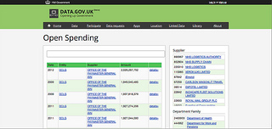
Spend browser for UK government
Key functions:
reconciles unstructured spreadsheets from across departments
makes government spending searchable across agencies
Implemented in 2012
UK spend browser

Slide 8
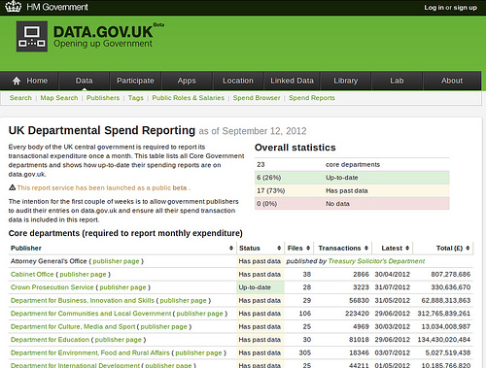
Reporting dashboard: benchmark agencies to drive reporting compliance
The UK Spend Reporting Dashboard developed for data.gov.uk. Key functions:
reconciles unstructured spreadsheets from across departments
makes government spending searchable across agencies
Customized browser
How well do government agencies report?

Slide 9
Why work on a budget specification?

Slide 10







Who uses budget data?
The governments themselves
Inter-governmental institutions
Information intermediaries

Slide 11
Better budgetary standards → improved release monitoring and sharing
The OpenSpending Budget Data Package project:
Why: budget standard → improve data flows, enable better analytics and visualisations
What we've done: six months in-depth research into best practises around budget data
Result: a budget data package
Next: stress test with studies in specific countries, develop new visualisation tools and automatic loading of budget data
Why standardised release matters

Slide 12
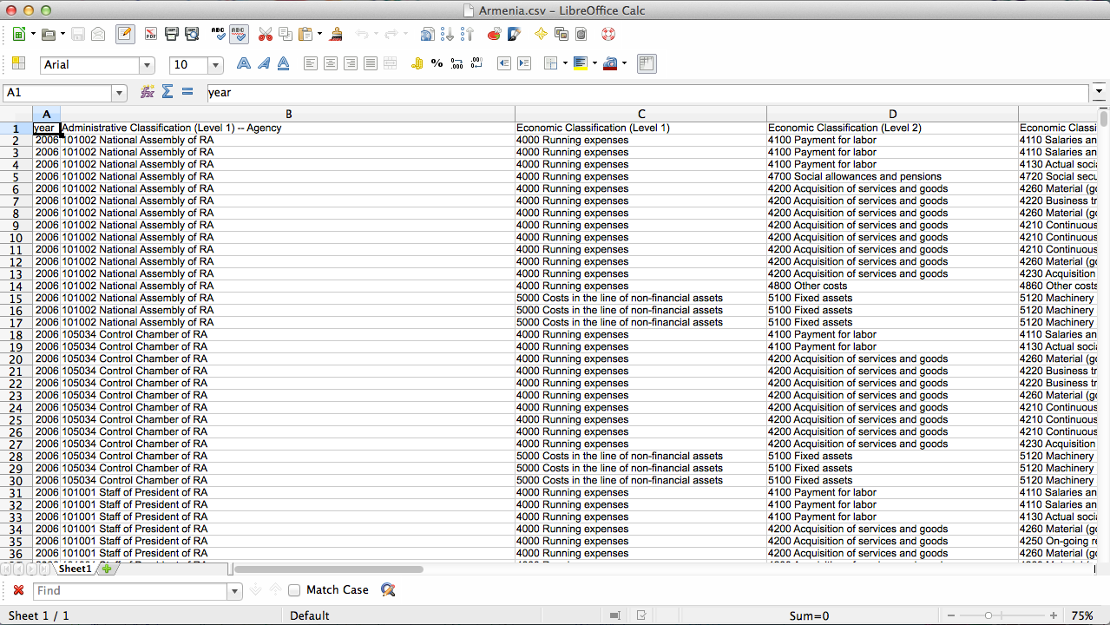

Slide 13
Bringing it all together
The Tower of Budget-Babel
Common data format
Match publisher workflow to user needs
Best practices from both worlds
No disruption to existing budgeting techniques

Slide 14



Design decisions
Simplicity
Comparability
Flexibility

Slide 15
Simplicity - key for adoption
Simple, universal components:
Spreadsheet data (CSV)
Plain-text descriptive metadata (JSON)
Much easier to use than alternatives (XML, RDF, …)
Two files keeps data simple:
Repetitive data goes into metadata

Slide 16
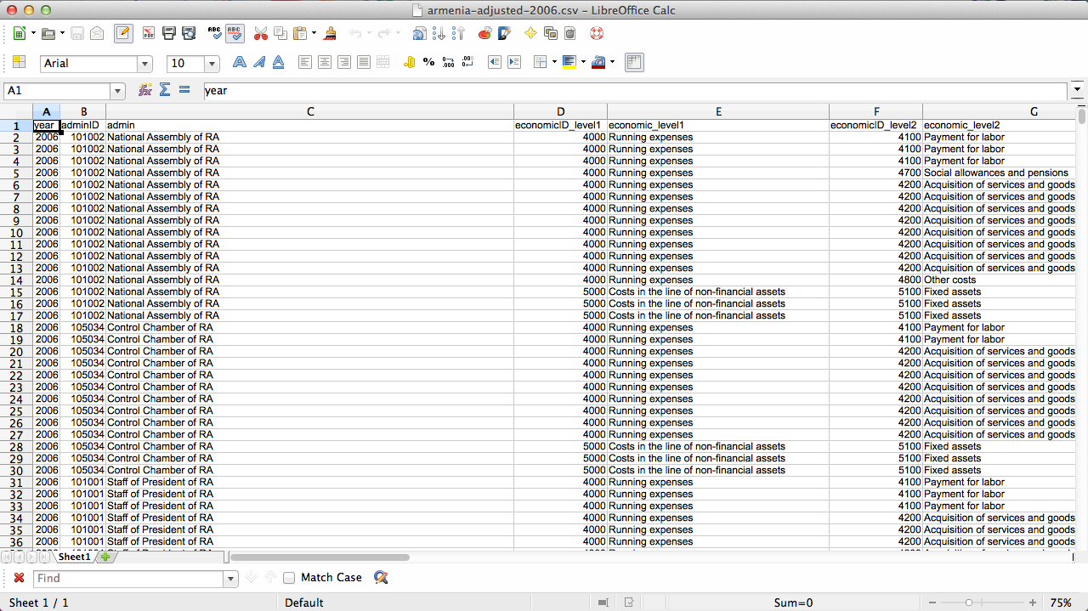

Slide 17
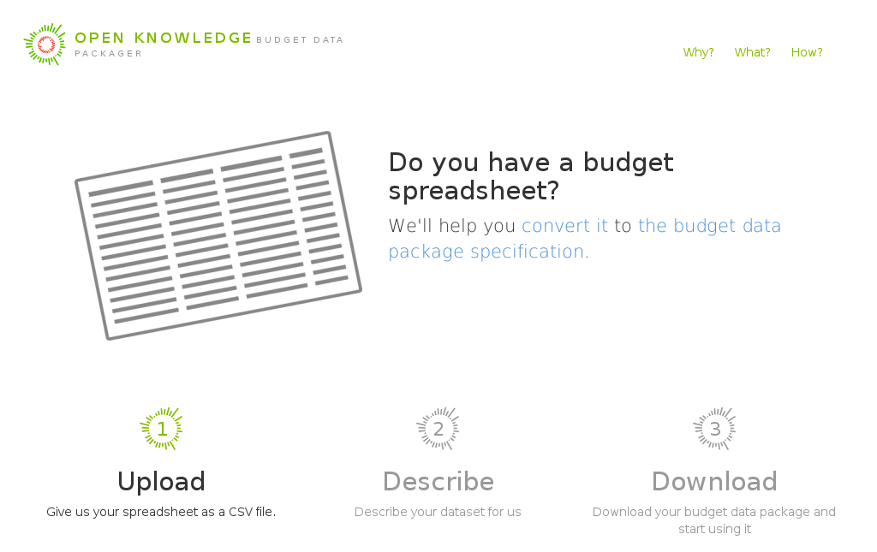
Budget Data Packager

Slide 18
Comparability
Required fields make meaningful budget comparisons possible
COFOG used by e.g. Eurostat to compare EU spending data
GFSM is the economic classification used by the IMF
Unique IDs make it possible to connect datasets
Budget line item IDs: connect spending and contracts
Unique dataset & package names: stable links to data

Slide 19
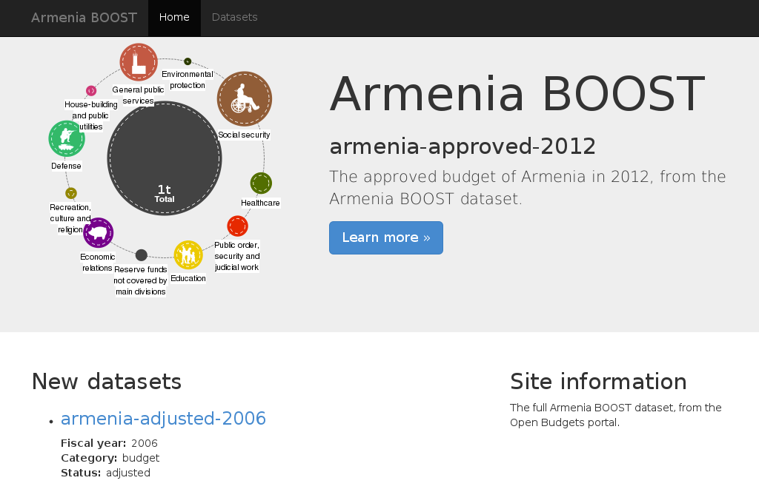
Budget in a Box

Slide 20
Flexibility of budget data package
Few requirements, many recommendations
Local category systems still useable
e.g. COFOG vs. functional category
Covers data generated at all points of budget cycle
Statuses: proposed, approved, adjusted, executed
Both aggregated and transactional, expenditure and revenue

Slide 21
Codifying good practices
Inspired by exemplary budget data publications:
World Bank BOOST participants
Datasets suggested by OpenSpending community
Uses international classification systems and guidelines
COFOG and GFSM
IMF budget classification guidelines

Slide 22
Publication workflow
Categorize your data with standards
add COFOG to expenditures, GFSM to revenues
Set up the spreadsheet(s)
change headers to match specification
create separate files (one per fiscal year, status, category)
Create the metadata file
one file per package
one part per dataset

Slide 23

Next: Integration and interoperability
XBRL to CSV converter
Validator
Metadata creator
CKAN - OpenSpending
Visualisations
Classification mappings

Slide 24
Thank you!
Anders Pedersen
@anpe
anders.pedersen@okfn.org

